Slide 2
Loved and called
Called to love

Slide 3
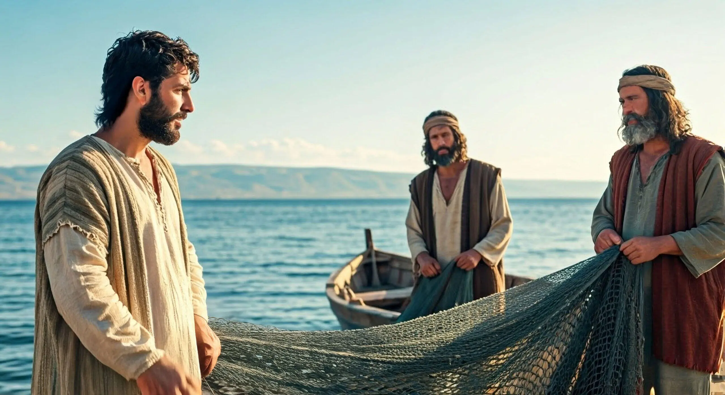
Loved and called

Slide 4

Evangelism
Social action

Slide 5



Slide 6
Evangelism
Social action

Slide 7
Your homegroup
The children’s groups
The youth
Men’s Ministry
Dwell -the women’s ministry
Friendship Club
Prayer partnership
You

Slide 8


Slide 9
Loved and called
Called to love

Slide 10


Slide 11
